Slide 1
AGRICULTURE INFORMATION SYSTEM.
HUMAN COMPUTER INTERACTION.
ISAD254SL
GROUP NUMBER - 76

Slide 2

Acknowledgment.
We would like to express our special thanks and appreciation to Mrs. Pavithra Subhashini, Head of our Module. By doing this assignment we have developed a lot of data that can help us in our future. We would like to thank the academic staff of NSBM and the authorized and specialized hosting staff at the Faculty of Computing branch for their support through our alumni studies. We would like to thank our team for helping us to participate throughout our lives. Everyone who helped us is greatly appreciated.

Slide 3
INTRODUCTION.
An Agricultural Information System can be defined as “a system in which agricultural information is generated, transformed, transferred, consolidated, received and fed back in such a manner that these processes function synergistically to underpin knowledge utilization by agricultural producers.” (Roling, 1988).
What is an agricultural information system?
The Agricultural resource Information System (AgRIS) is an e-governance program launched by the Department of Agriculture and Cooperation (DAC) to promote agricultural growth, poverty alleviation and sustainable resource use at the grassroots level in India.

Slide 4
PROBLEM STATEMENT.
In today’s world of technology and the digital world, people need to rely on the internet to complete their tasks and learn new information. People use blogs and software as anti-blogging. In this case, the most important feature of these websites and applications is GUI. To achieve this, we need to create user-friendly as well as easy-to-manage user interfaces. As part of this course, we will design interfaces for an agricultural information system. As a result, we have primary target audiences as well as producers and agricultural workers. Then came the key issues: First, our site must be quick and easy for our audience to understand, and second, it must be truly user-friendly.

Slide 5
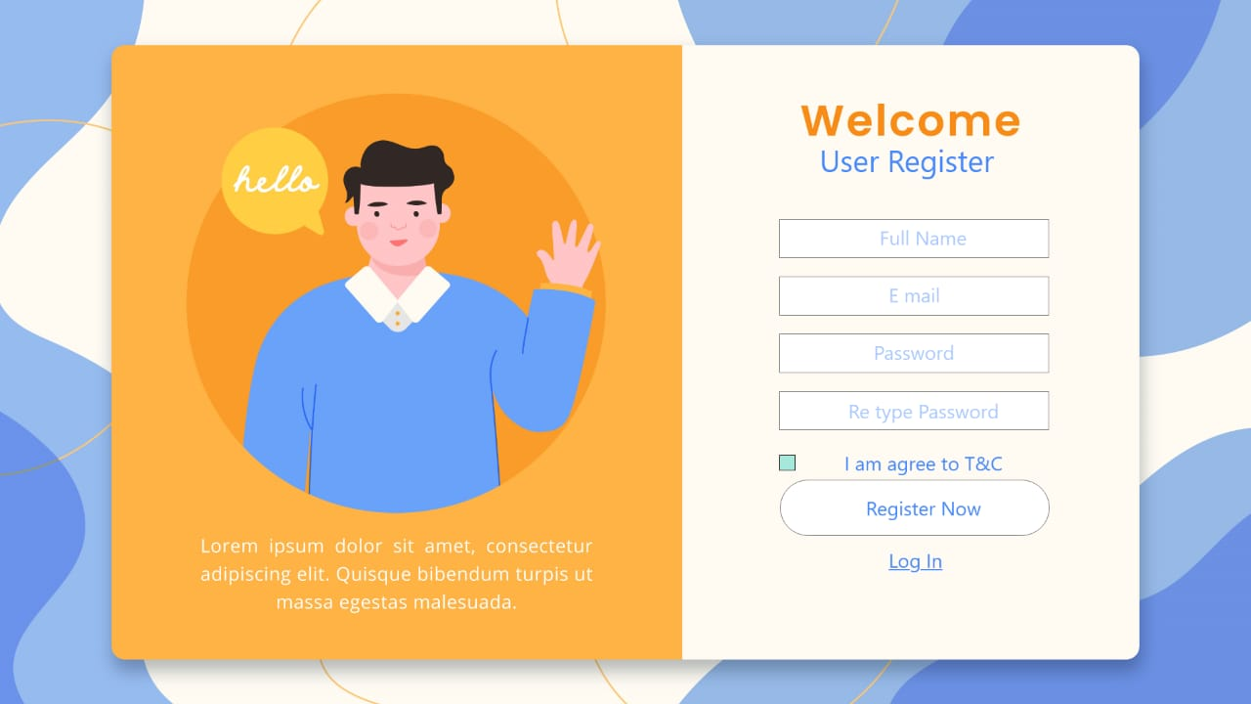
USER REGISTER.
In this Prototype user can Register to the system users can easily register cognitive feature use is Attention capacity.

Slide 6
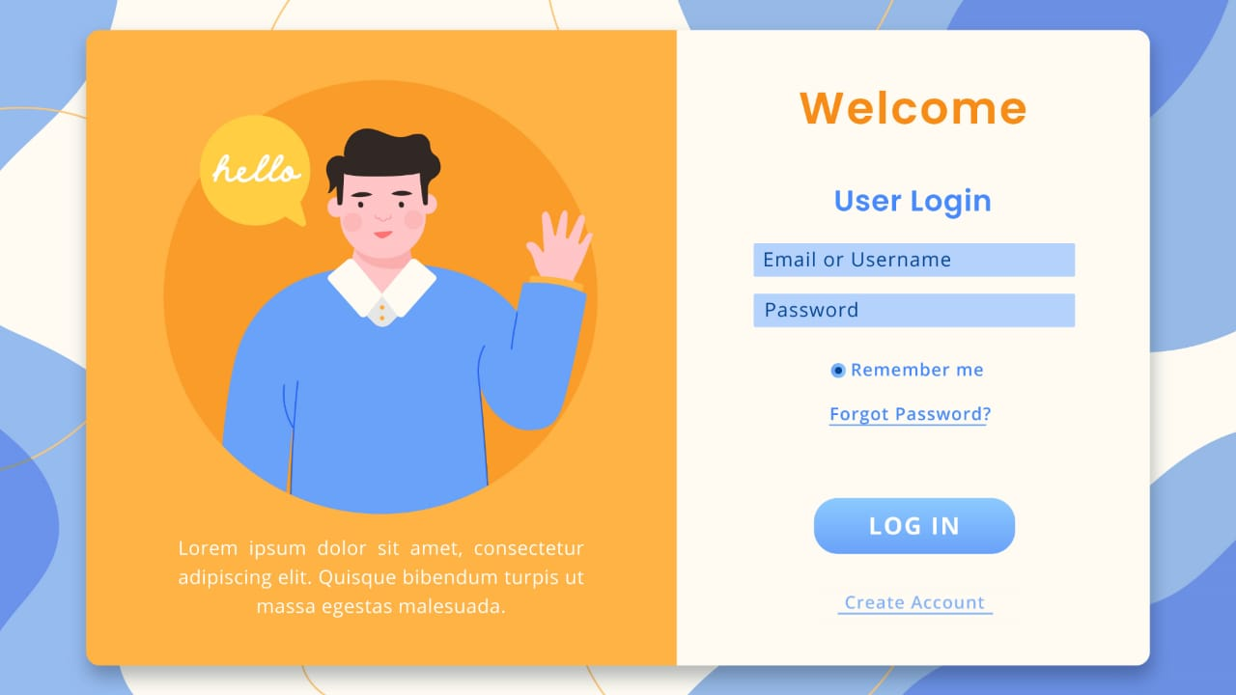
USER LOGIN.
Login Prototype is a simple design clear colors and text were used. Easy to access. Only need to fill two fields.

Slide 7
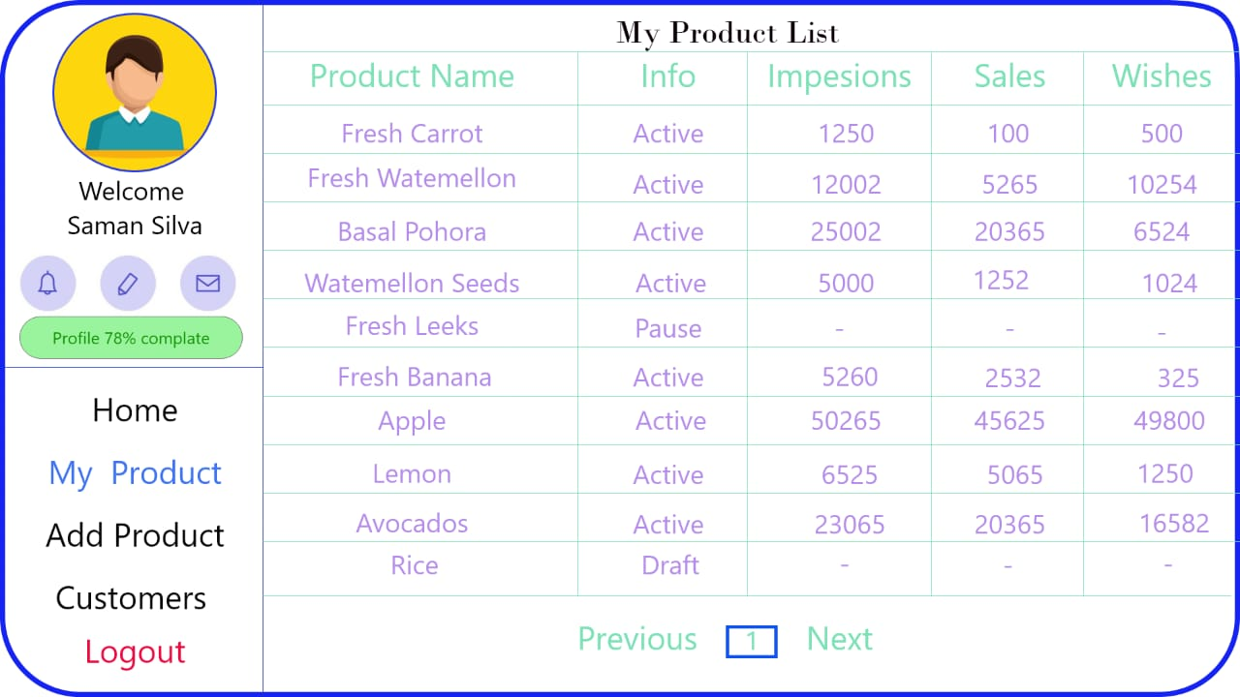
SELLER BOARD – MY PRODUCT.
Using this Prototype farmers can view their customer stats clear fonts were used.

Slide 8
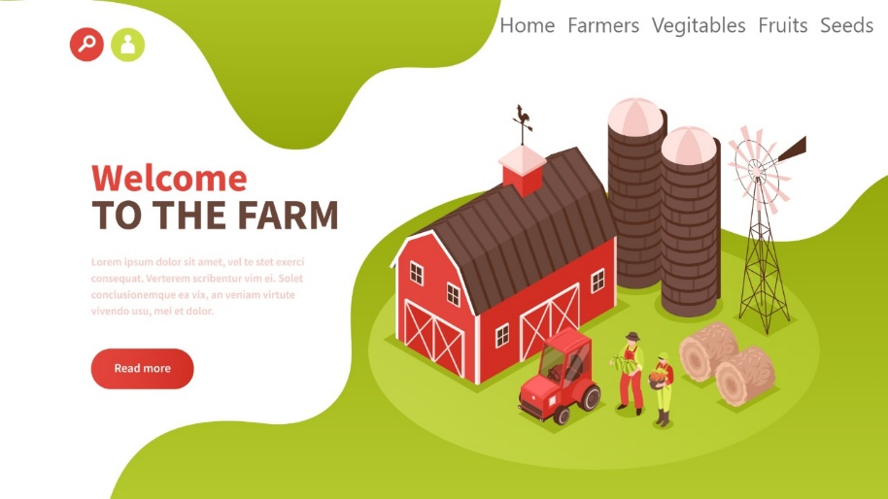
Home Page - Welcome to the Farm.
Welcome to the Farm is a simple page with a navigation bar. Clear background colors and images were used.

Slide 9
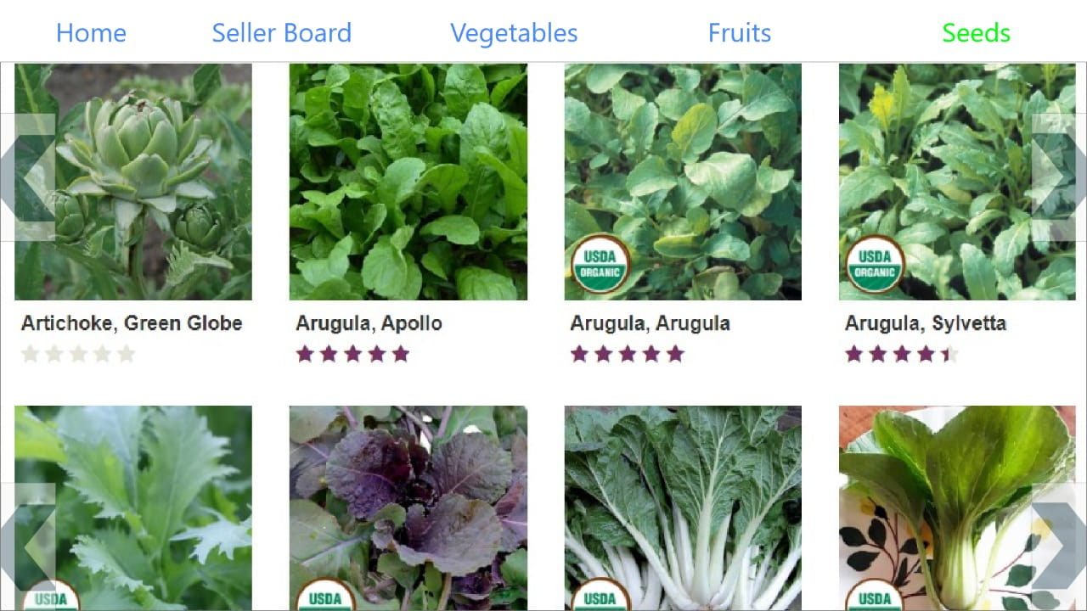
seeds.
Contains a navigation bar seeds which are to be sold can be viewed colors are used for fonts.

Slide 10
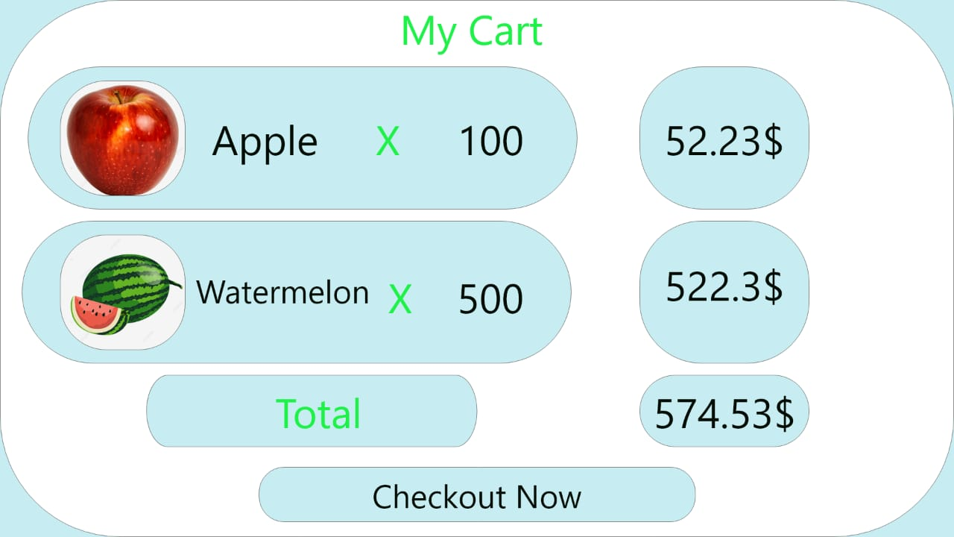
My CART.
Purchased items can be viewed in the cart prototype user can see his bill using this.

Slide 11
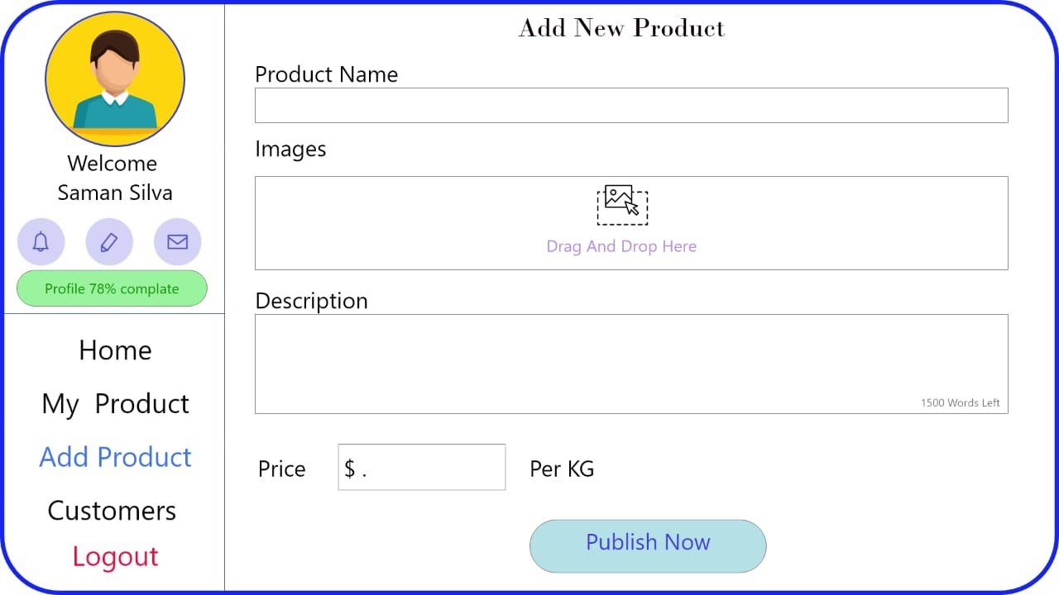
ADD PRODUCT.
Farmers can add their products using this prototype only four fields are needed to be filled this user friendly.

Slide 12
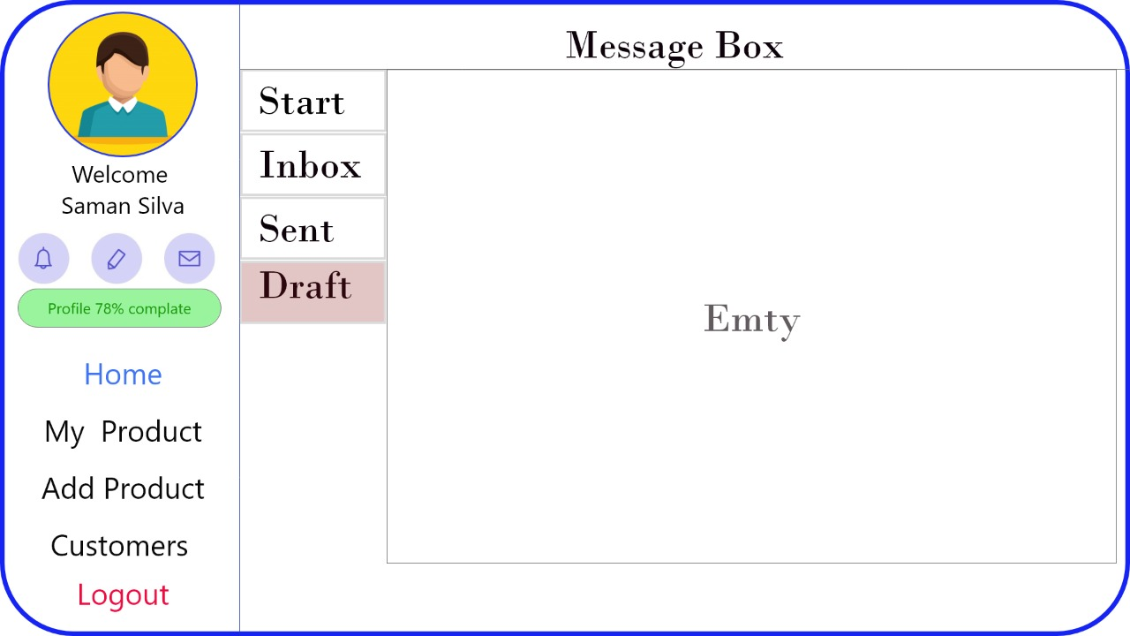
MESSAGE BOX - DRAFT.
Unsent messages can be viewed using Draft.

Slide 13
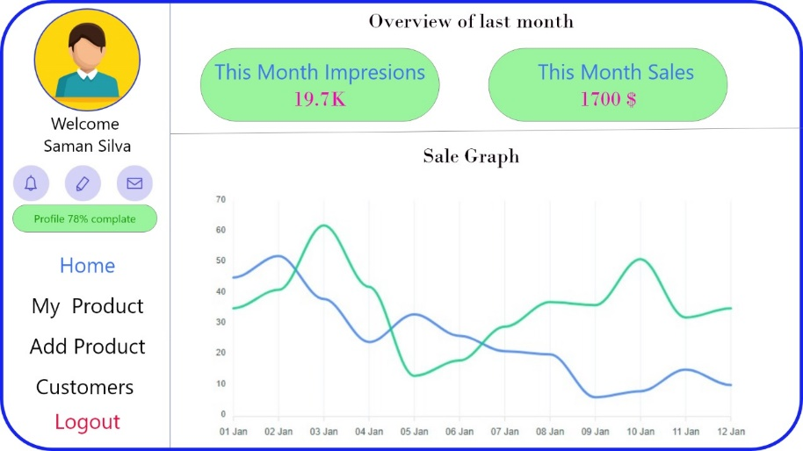
SELLER BOARD – overview of last month.
Using this farmer can gain an understanding about the monthly sales.

Slide 14
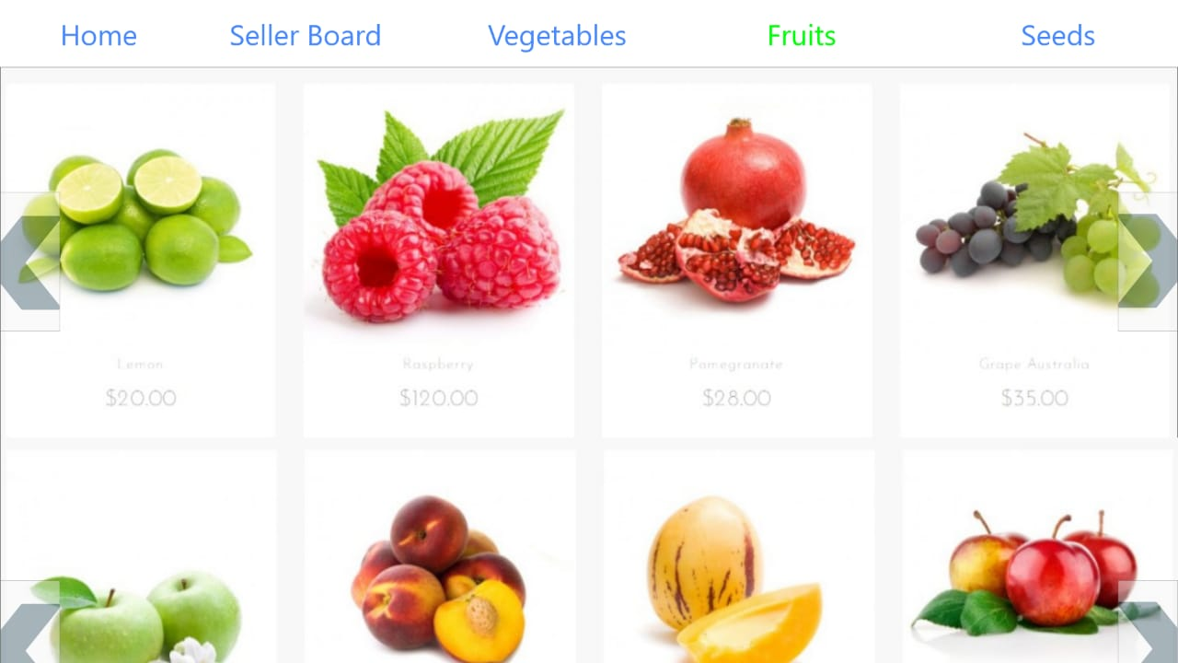
Fruits.
Contains a navigation bar fruits which are to be sold can be viewed colors are used for fonts.

Slide 15
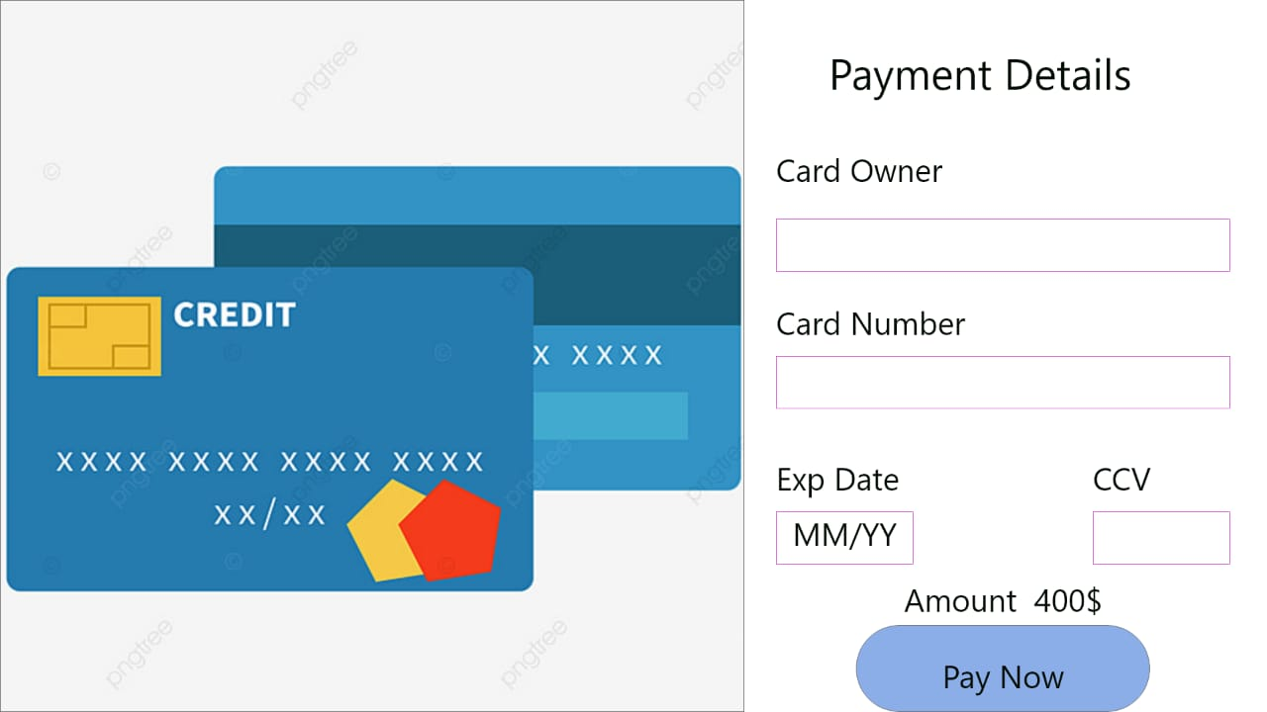
PAYMENTs.
This is a Payment method. It must be fill in card owner and card number.

Slide 16
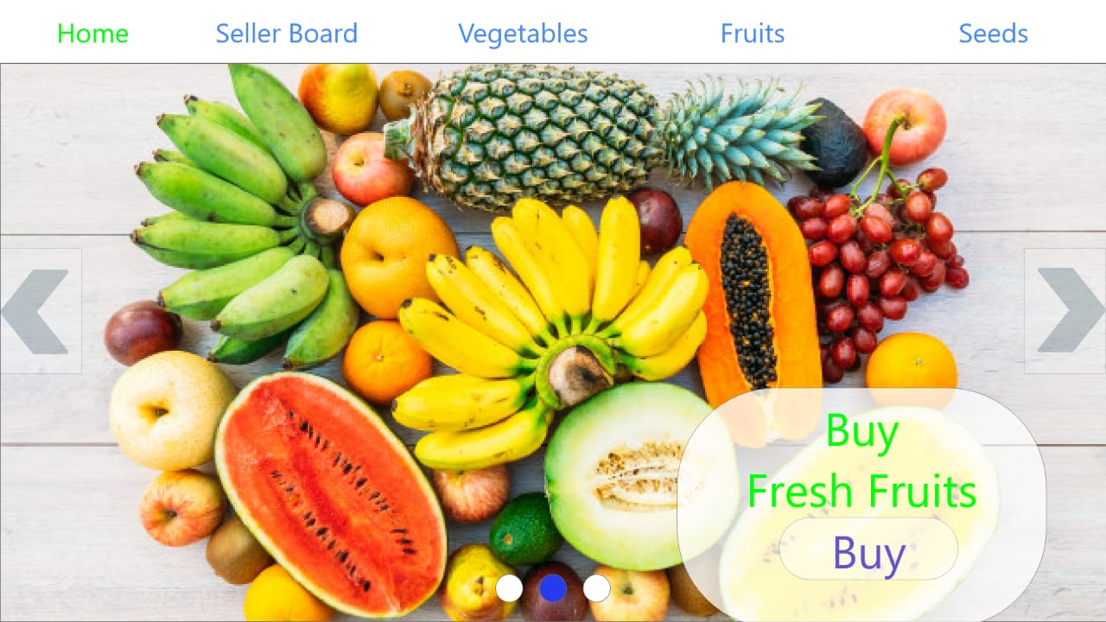
HOME PAGE - fruits.
Fruits landing page has a navigation bar user can navigate through the site using this and can buy Fruits.

Slide 17
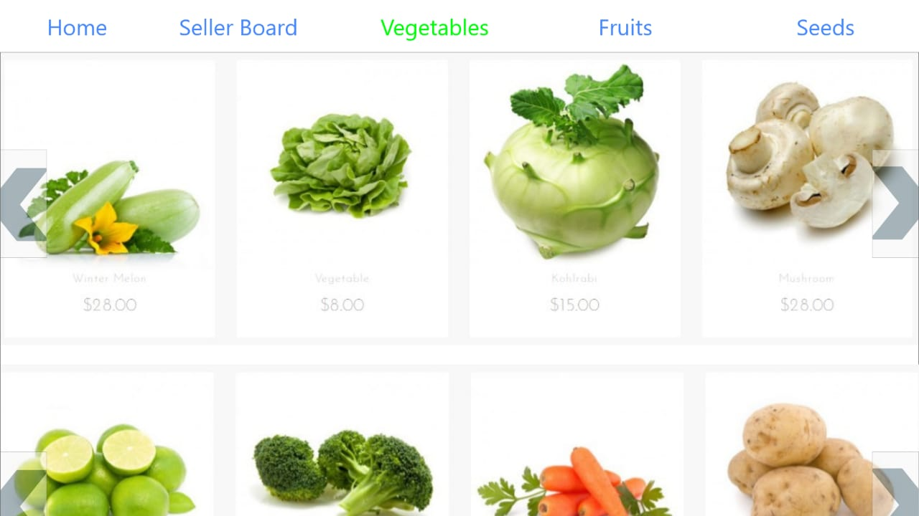
VEGETABLES.
Contains a navigation bar vegetables which are to be sold can be viewed colors are used for fonts.

Slide 18
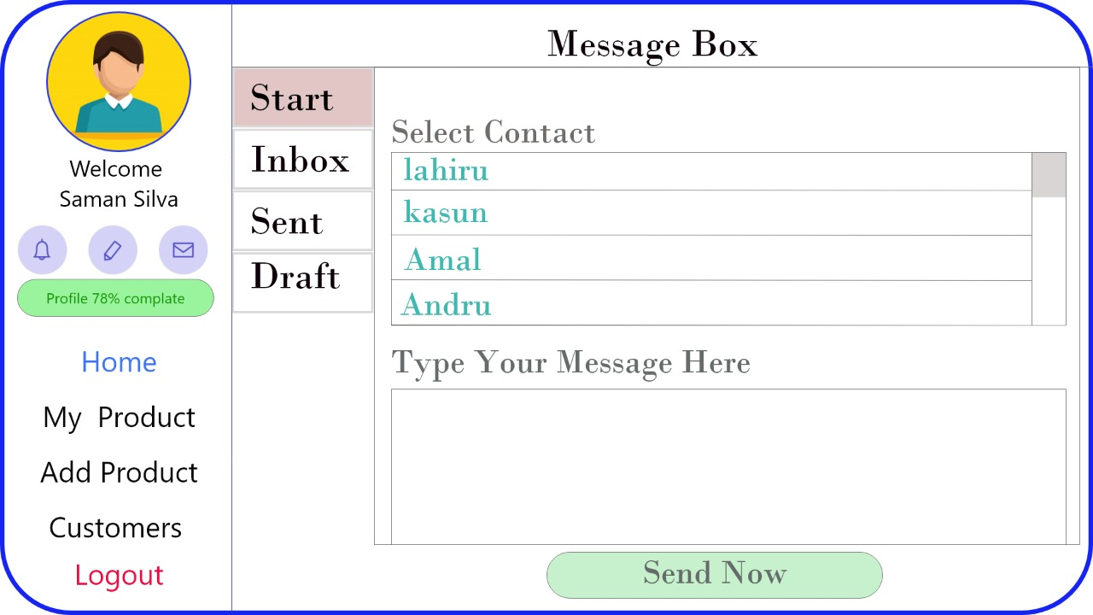
MESSAGE BOX – START.
Message box start is the page which will be displayed when using the message option.

Slide 19
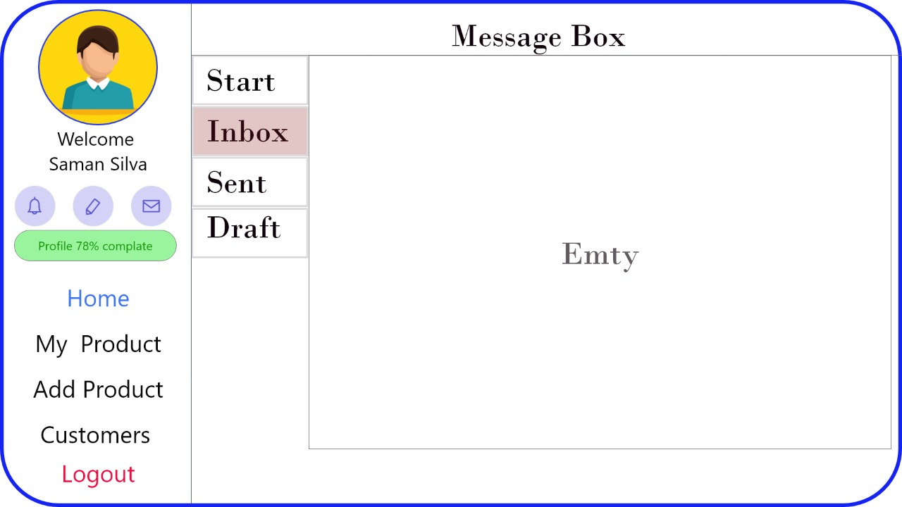
MESSAGE BOX – INBOX.
Using this prototype user can view his inbox. Larger fonts were used.

Slide 20
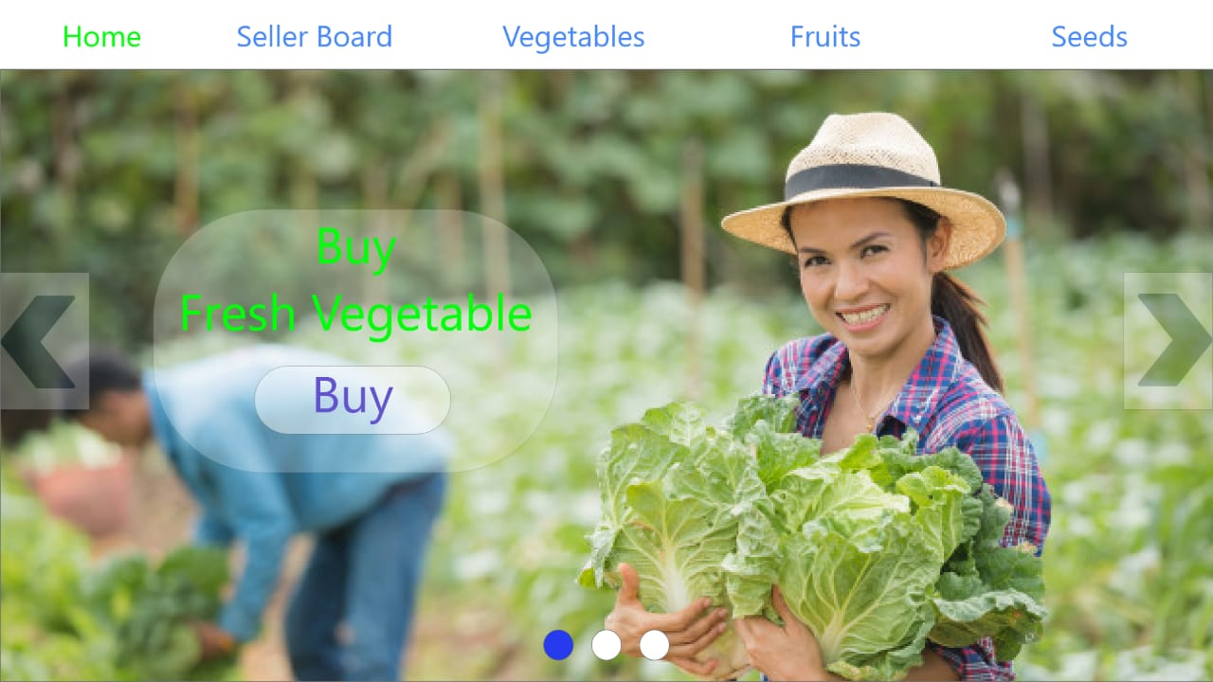
HOME PAGE - vegetables.
Vegetables landing page has a navigation bar. Users can buy Vegetables using this page.

Slide 21
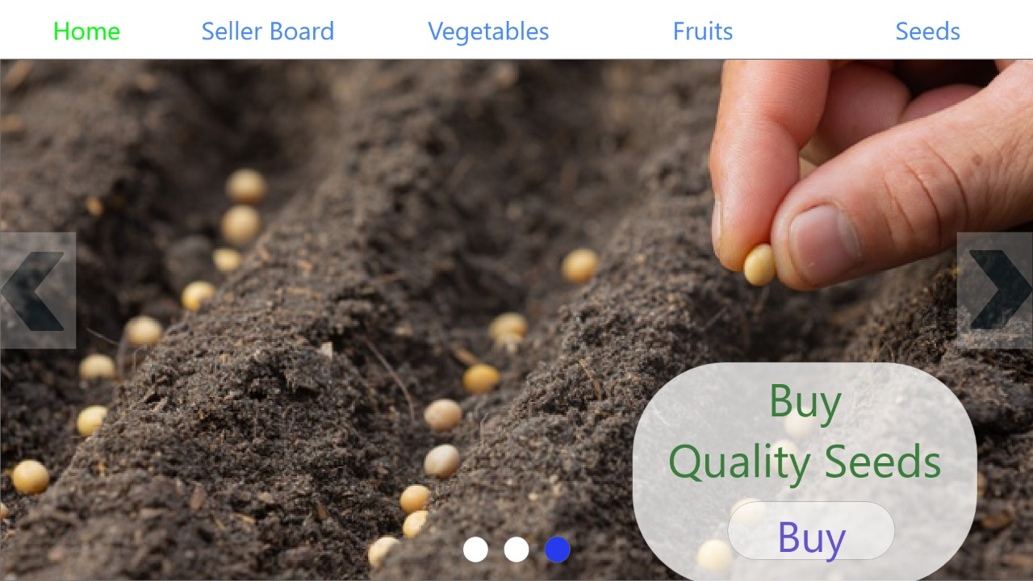
home page - Seeds.
Seed Landing page has a navigation bar. User can navigate through the site and proceed to buy seeds.

Slide 22
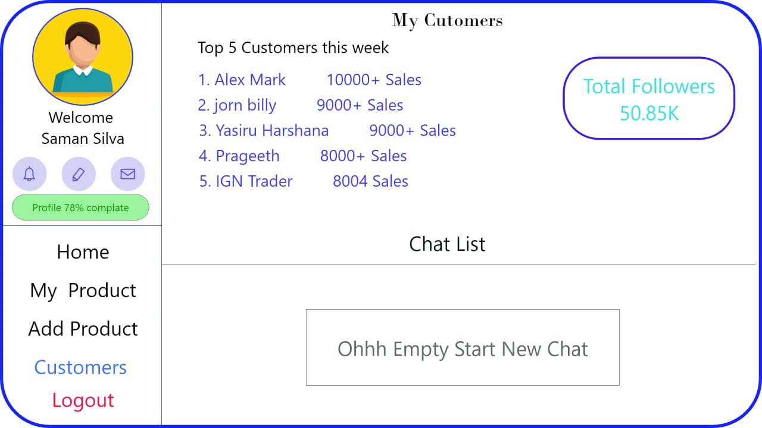
My Customers.
Farmers can see their customer states using this page. Bright colors were used for prototype.

Slide 23
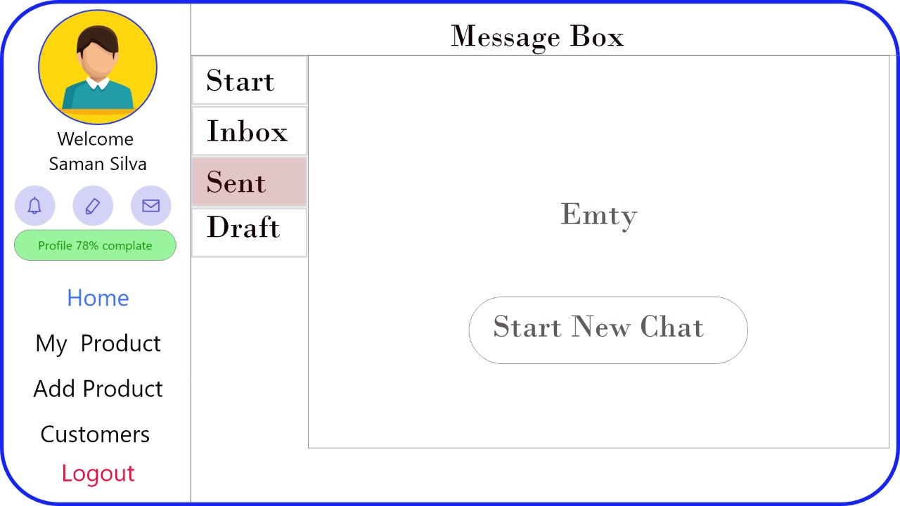
MESSAGE BOX - SENT.
In this user can see their sent messages. Minimum ui is used.

Slide 24
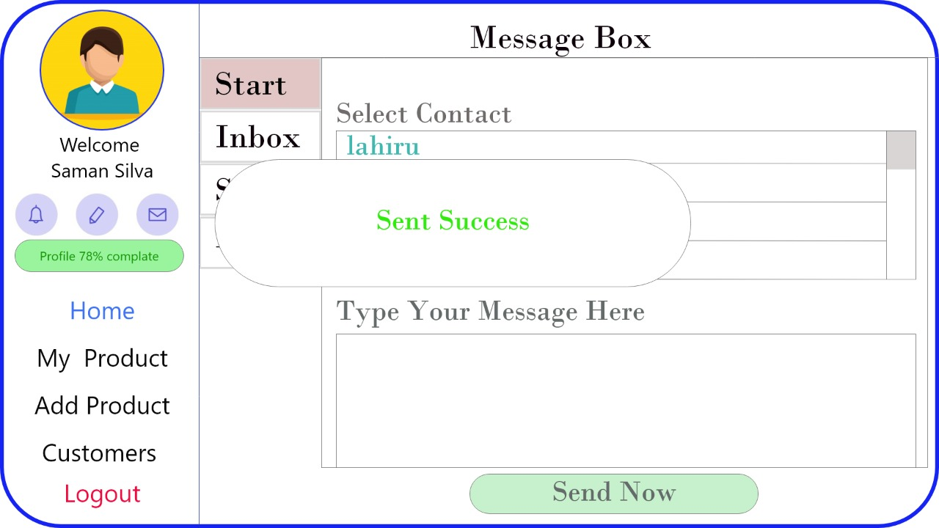
MESSAGE BOX - SENT.
User can send message through this prototype after sending the machine a message will displayed.

Slide 25
ID | NAME | DEGREE PROGRAM (SE/CN/CS)
10707362 | Saunda Sanjula | SE
10707193 | Ruhunu Fernando | SE
10707375 | Balage Silva | SE
10707202 | Sasindu Gamage | SE
10707428 | Ran Yasiru | SE
10707297 | Godella Pathirana | SE

Slide 26


